Slide 1



Special Session & Competitions on Single Objective Bound Constrained Numerical Optimization
Abhishek Kumar, P.N. Suganthan, Kenneth V. Price, Ali Wagdy Mohamed, Anas A Hadi
abhishek.kumar.eee13@iitbhu.ac.in , epnsugan@ntu.edu.sg , kvprice@pacbell.net, aliwagdy@gmail.com, anas1401@gmail.com

Slide 2
Contents
Introduction
A review for CEC2022 benchmark problems
Accepted algorithms
Ranking result

Slide 3

Introduction
Single objective optimization algorithms are the foundation upon which more complex methods, like multi-objective, niching and constrained optimization algorithms, are built.
Consequently, improvements to single objective optimization algorithms are important because they can impact other domains as well.
This interplay between methods and problems drives progress, so we have developed the CEC’22 Special Session on Real-Parameter Optimization to promote this symbiosis.
In this competition, the benchmark objective functions are parameterized by including the full rotation operators.
The main motive behind this parameterization is to test the effect of all algorithm on full rotated benchmark functions.
For this, 12 scalable benchmark problems are proposed with 10D and 20D.

Slide 4
Contents
Introduction
A review for CEC2022 benchmark problems
Accepted algorithms
Ranking result

Slide 5
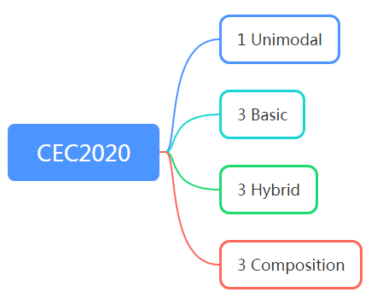
A review for CEC2022 benchmark problems
1 Unimodal
4 Basic
CEC 2022
3 Hybrid
4 Composition
This competition significantly increases the maximum number of allowed function evaluations

Slide 6
A review for CEC2021 benchmark problems
Information and features of the test problems suite
 | No. | Functions | F_{i}* = F_{i}(x*)
Unimodal Function | 1 | Shifted and Full Rotated Zakharov Function (Modified, CEC 2017 F3) | 300
Basic Functions | 2 | Shifted and Full Rotated Rosenbrock’s Function (Modified, CEC 2017 F4) | 400
 | 3 | Shifted and Full Rotated Expanded Schaffer’s f6 Function (Modified, CEC 2017 F6) | 600
 | 4 | Shifted and Full Rotated Non-Continous Rastrigin Function (Modified, CEC 2017 F8) | 800
 | 5 | Shifted and Full Rotated Levy Function (Modified, CEC2017 F9) | 900
Hybrid Functions | 6 | Hybrid Function 1 (N = 3) (CEC 2014 F18) | 1800
 | 7 | Hybrid Function 2 (N = 6) (CEC 2017 F20) | 2000
 | 8 | Hybrid Function 3 (N = 5) (CEC 2014 F22) | 2200
Composition Functions | 9 | Composition Function 1 (N = 3) (CEC 2017 F22) | 2200
 | 10 | Composition Function 2 (N = 4) (CEC 2017 F24) | 2400
 | 11 | Composition Function 3 (N = 5) (CEC 2017 F26) | 2600
 | 12 | Composition Function 4 (N = 6) (CEC 2017 F27) | 2700
Search range: [-100,100]^{D}

Slide 7
Contents
Introduction
A review for CEC2022 benchmark problems
Accepted algorithms
Ranking result

Slide 8
Accepted Algorithms

Slide 9
Contents
Introduction
A review for CEC2022 benchmark problems
Accepted algorithms
Ranking results

Slide 10
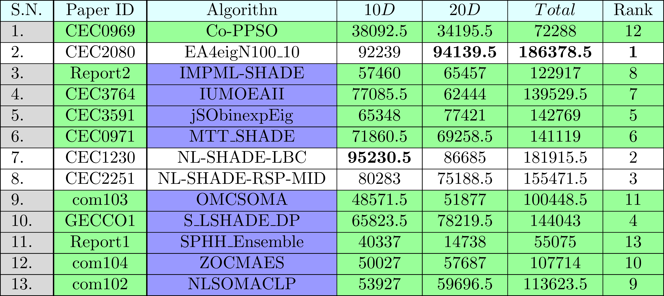
Ranking Result
Final Ranking of the accepted algorithms for Rotated Shifted Cases

Slide 11
Thanks for your attention!

